Slide 1
Deep learning for computer vision
Dr. Hasan Firdaus Bin Mohd Zaki
Acknowledgements: Materials for this slide were adapted from MIT deep learning, learnopenCV, and UWA

Slide 2
Agenda
Time | Agenda
9-10 | Introduction & some theoretical Deep Neural Networks - Setup anaconda + download dataset
10-11 | Practical 1: Deep Neural Networks Using MNIST
11 – 12.20 | Convolutional Neural Networks (CNN) + Practical 2 (CNN from scratch (MNIST/ own data)
12.20- 1 | Pre-trained model (Theory + Practical 3)
1-2.15 | Lunch, Solat, Break
2.15- 3.15 | Transfer Learning (Theory + Practical 4)
3.15- 4.15 | Fine-tuning (Theory + Practical 5)

Slide 3
Lets learn together!
What and why deep learning?
Why deep learning works so well
Neural network as blackbox
Training neural network
Some practical matters
Understanding input, output, weight/parameters

Slide 4
Scope for today
Deep learning for computer vision
Supervised learning
For classification task only

Slide 5
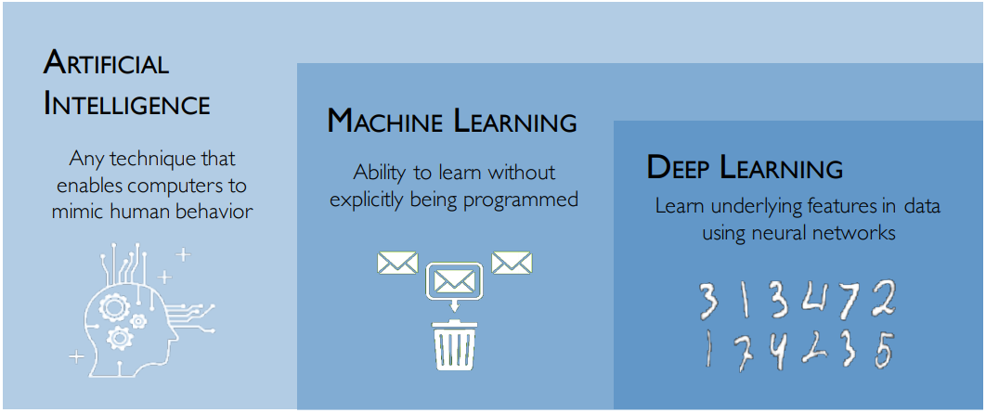
Deep Learning?

Slide 6
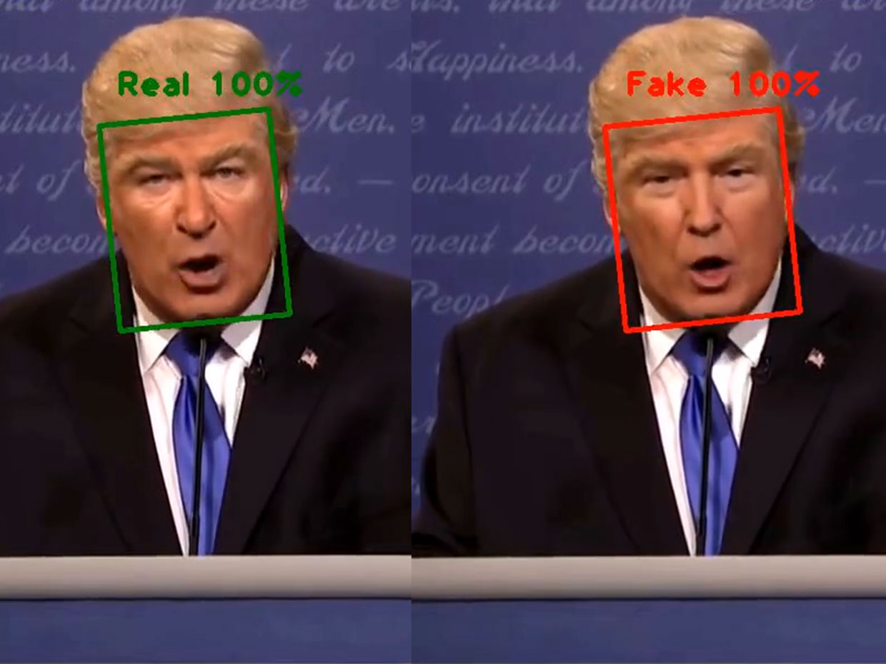
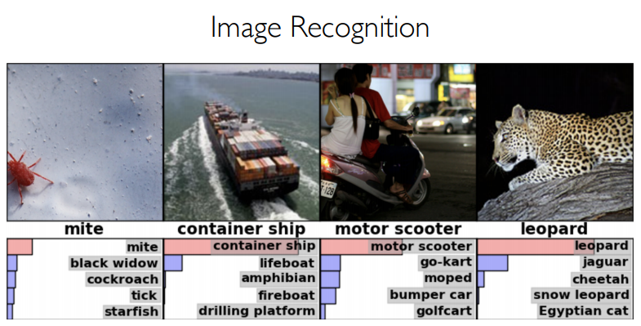
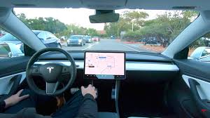
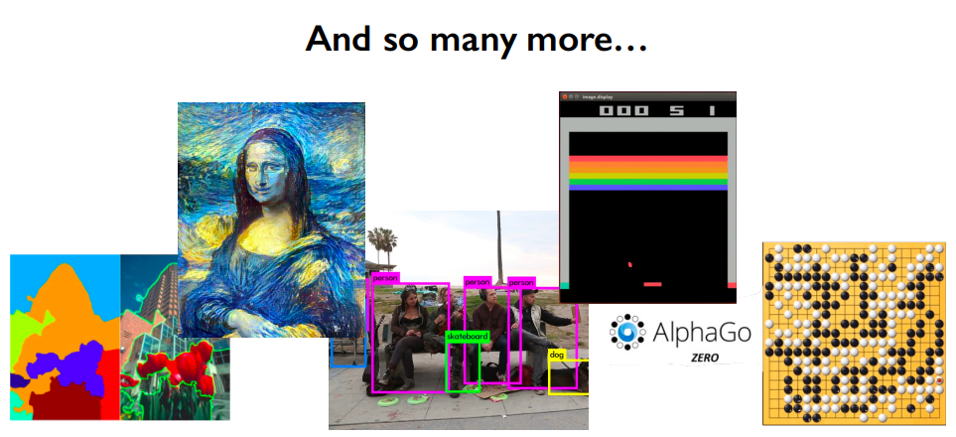
Success Stories

Slide 7
Feature Engineering vs. Learning
Feature engineering is the process of using domain knowledge of the data to create features that make machine learning algorithms work. E.g: SIFT for image processing, MFCC for audio, etc
“When working on a machine learning problem, feature engineering is manually designing what the input x's should be.” - Shayne Miel, Turnitin
“Coming up with features is difficult, time-consuming, requires expert knowledge.” - Andrew Ng

Slide 8
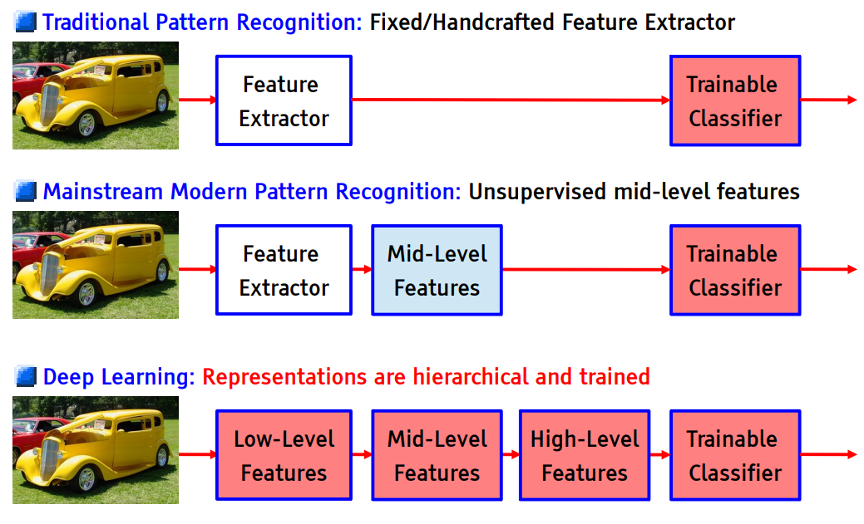
Handcrafted VS Learning

Slide 9
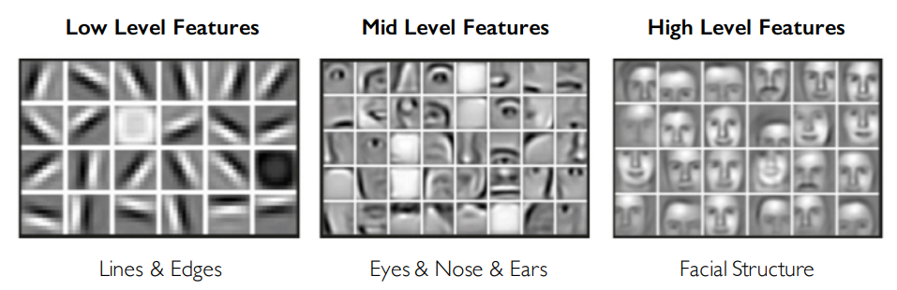
Why Deep Learning?
Hand engineered features are time consuming, brittle and not scalable in practice
Can we learn the underlying feature representation directly from data?

Slide 10
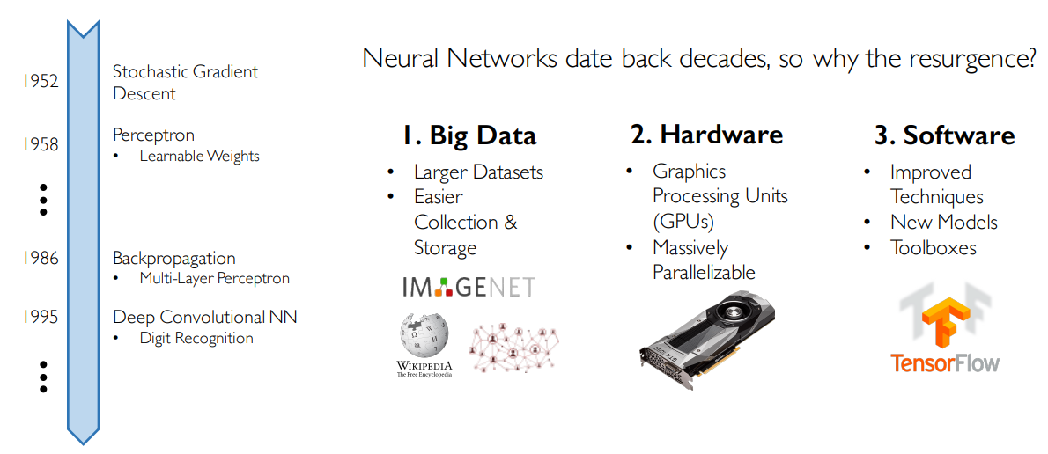
Why Now?

Slide 11
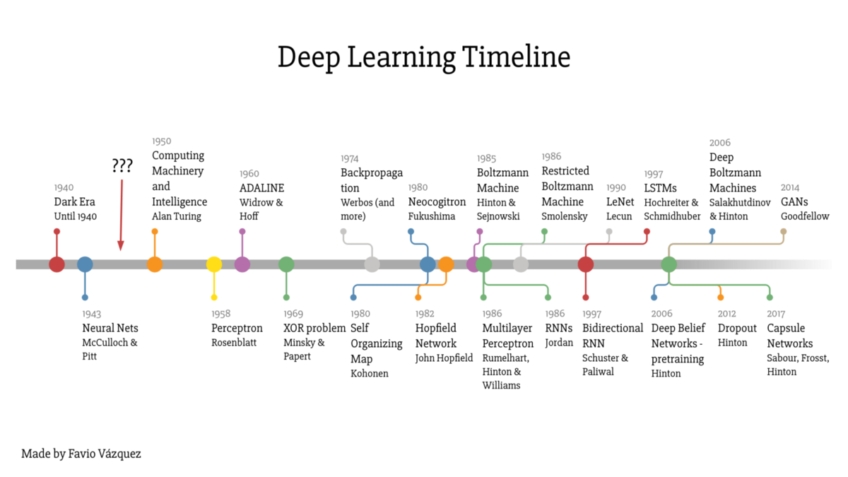

Slide 12
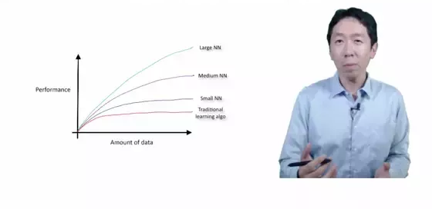
How scale is enabling deep learning

Slide 13
Perceptron
The structural building block of deep learning

Slide 14
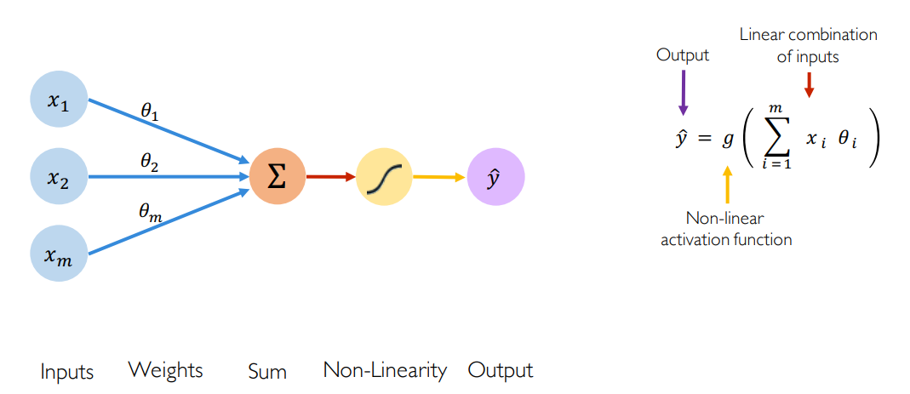
The Perceptron: Forward Propagation

Slide 15
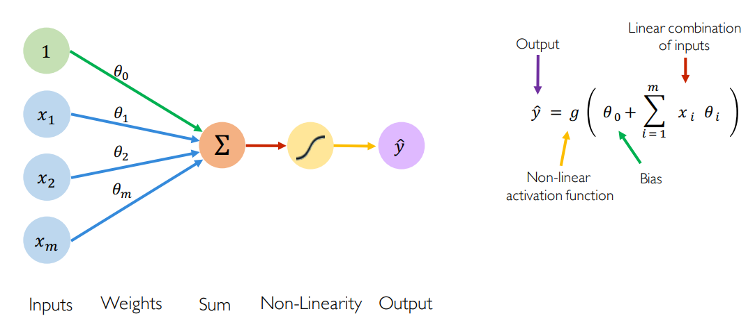
The Perceptron: Forward Propagation

Slide 16
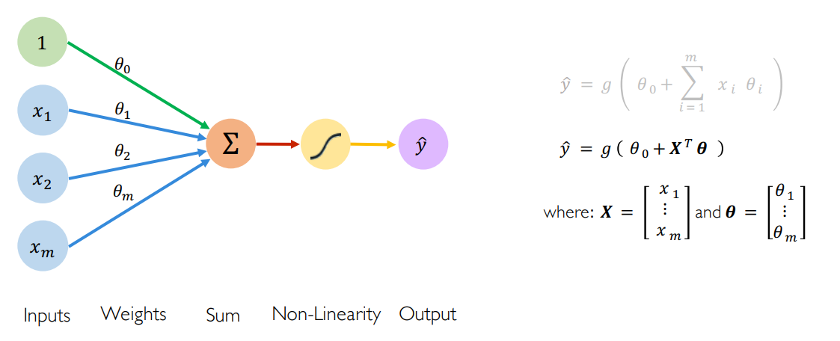
The Perceptron: Forward Propagation
Vectorization (for speed up)

Slide 17
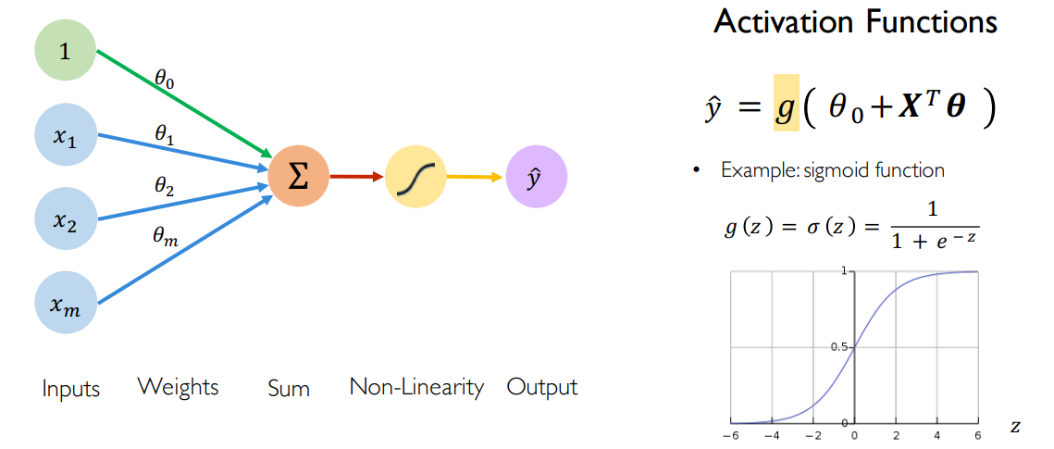
The Perceptron: Forward Propagation

Slide 18
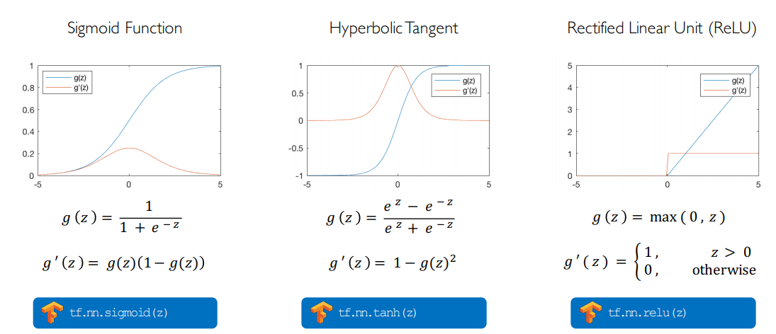
Common (Non-linear) Activation Functions

Slide 19
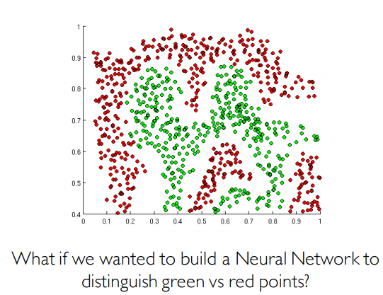
Importance of Activation Functions
The purpose of activation functions is to introduce non-linearities into the network

Slide 20
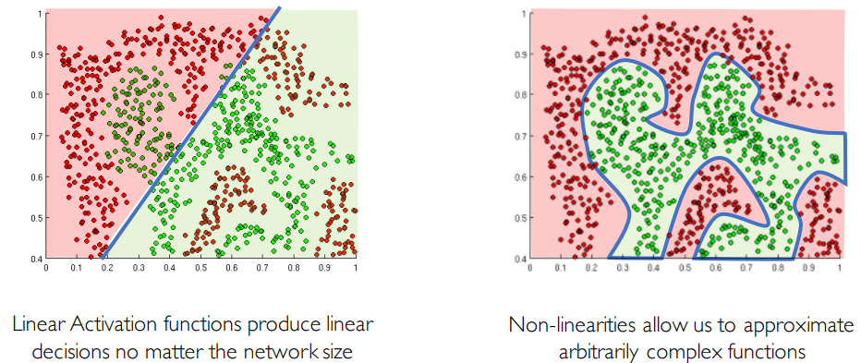
Importance of Activation Functions
The purpose of activation functions is to introduce non-linearities into the network

Slide 21
Building Neural Networks with Perceptrons

Slide 22
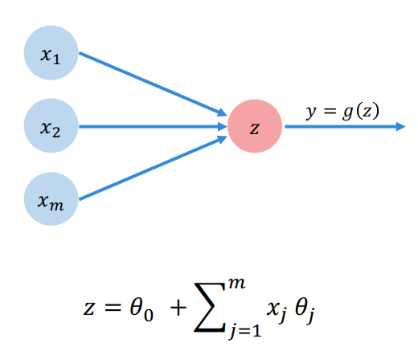
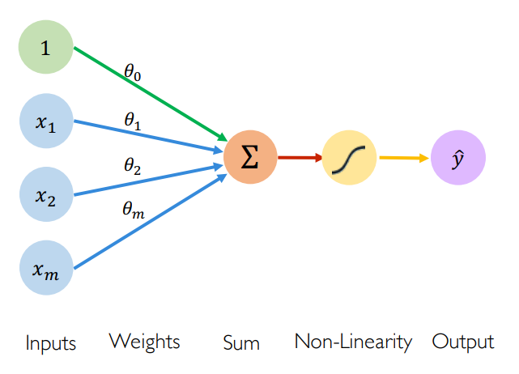
The Perceptron: Simplified

Slide 23
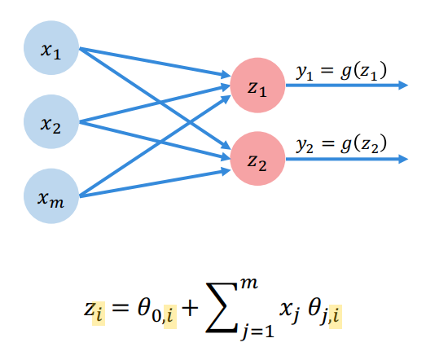
Multi Output Perceptron

Slide 24
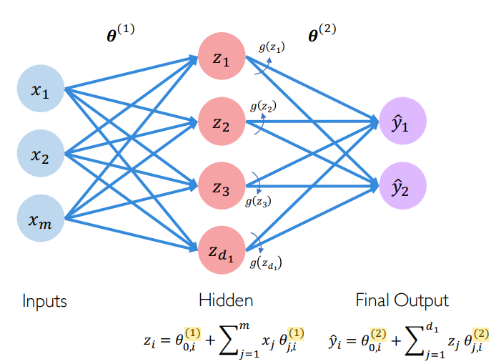
Single Layer Neural Network

Slide 25
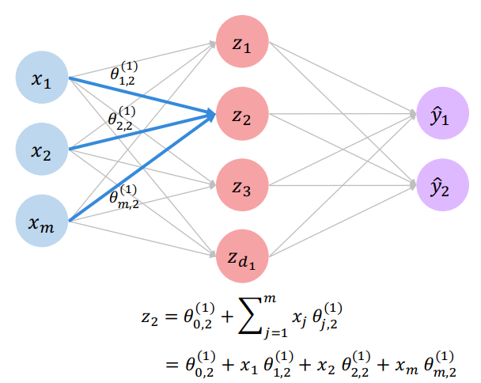
Single Layer Neural Network

Slide 26
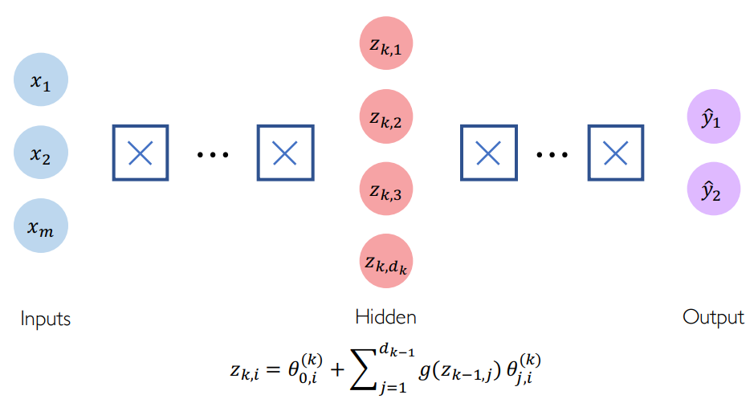
Deep Neural Network

Slide 27
Applying Neural Networks

Slide 28
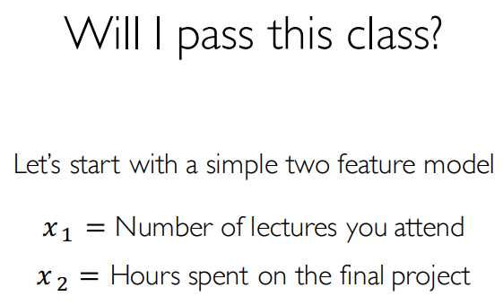
Example Problem

Slide 29
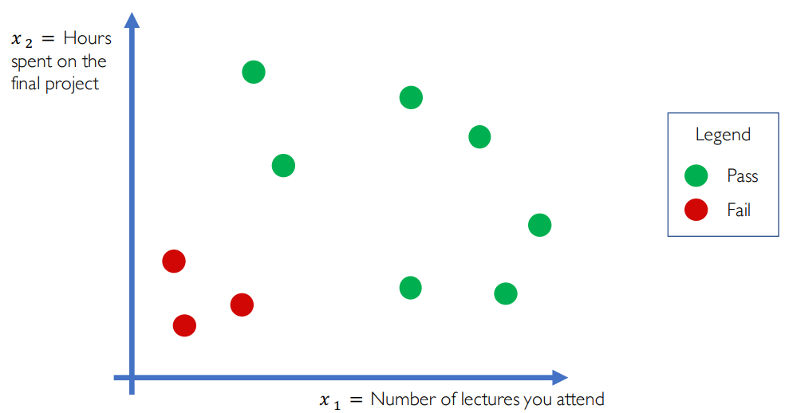
Example Problem: Will I pass this class?

Slide 30
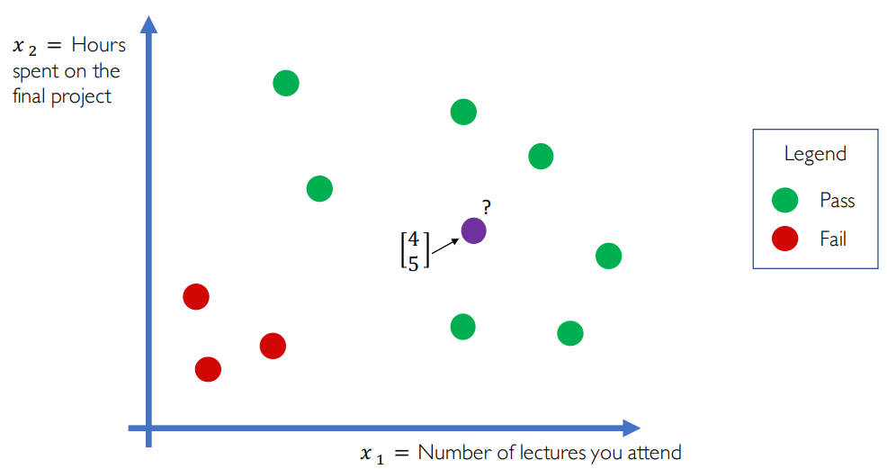
Example Problem: Will I pass this class?

Slide 31
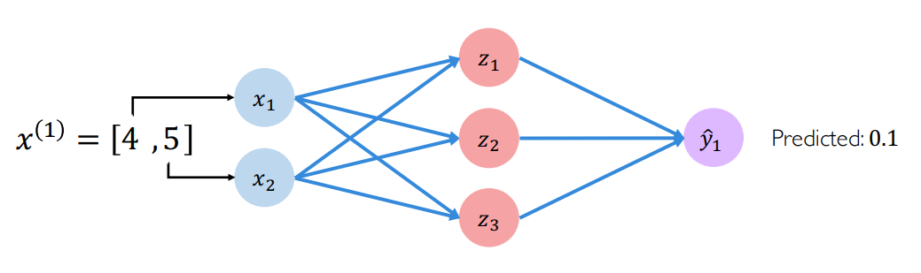
Example Problem: Will I pass this class?

Slide 32
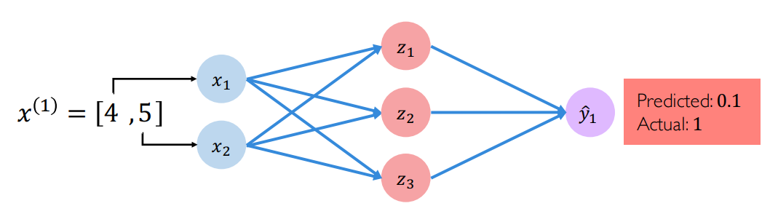
Example Problem: Will I pass this class?

Slide 33
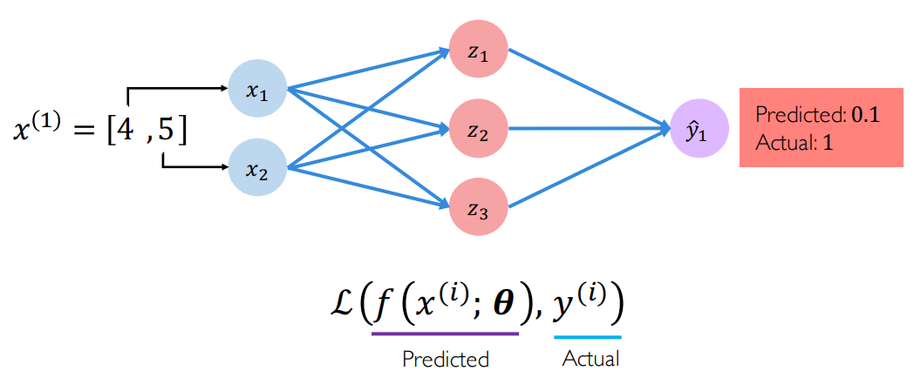
Quantifying Loss
The loss of our network measures the cost incurred from incorrect predictions

Slide 34
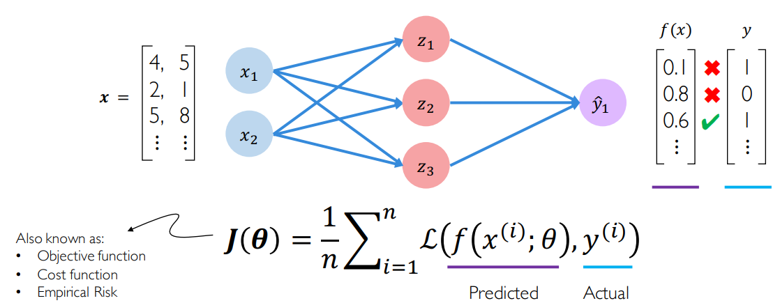
Empirical Loss
The empirical loss measures the total loss over our entire dataset

Slide 35
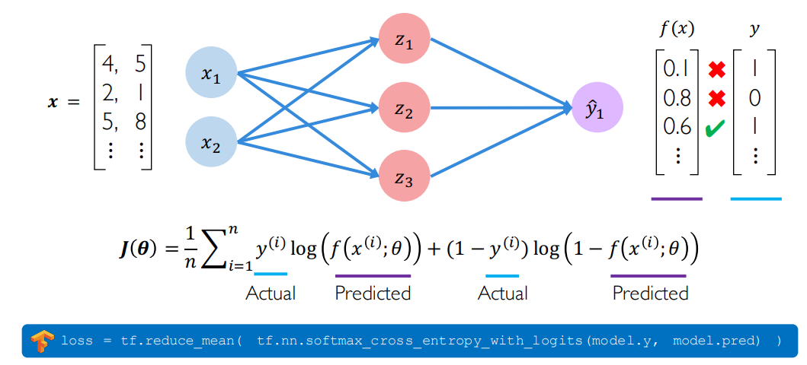
Binary Cross Entropy Loss
Cross entropy loss can be used with models that output a probability between 0 and 1

Slide 36
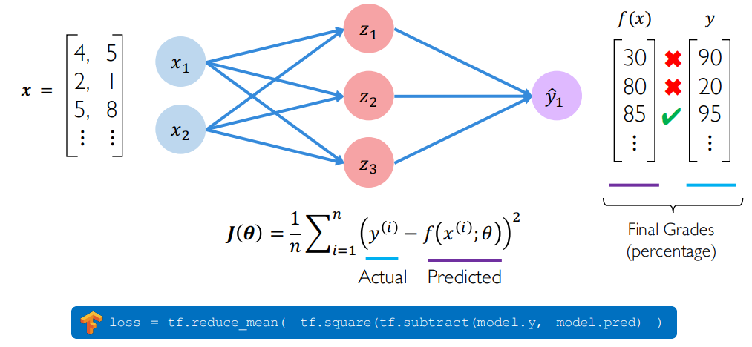
Mean Squared Error Loss
Mean squared error loss can be used with regression models that output continuous real numbers

Slide 37
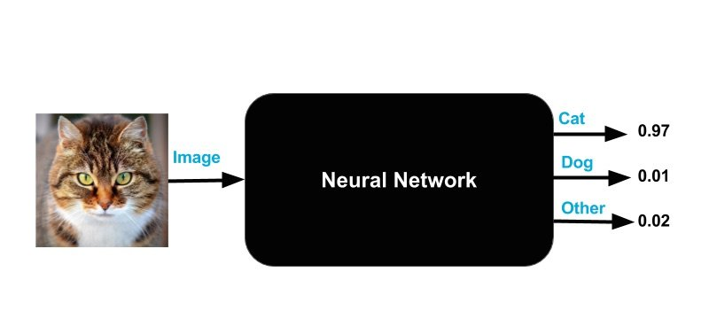
Neural Networks as a blackbox
Pretend you don’t know what’s inside the blackbox
You want to classify cat, dog and others (not cat or dog)
Image as input
The three outputs are numbers between 0 and 1. The outputs are labeled “Cat”, “Dog”, and “Other”. The three numbers add up to 1.

Slide 38
Understanding the Neural Network Output
A perfect neural network would output (1, 0, 0) for a cat, (0, 1, 0) for a dog and (0, 0, 1) for anything that is not a cat or a dog
The outputs can be interpreted as probabilities – e.g. the black box “thinks” there is a 97% chance that the input image is that of a cat and a small chance that it is either a dog or something it does not recognize

Slide 39
How about the input?
Images are just an array of numbers.
A 256×256 image with three channels is simply an array of 256x256x3 = 196,608 numbers
Therefore, there are 196,608 input neurons (flatten, fixed size)

Slide 40
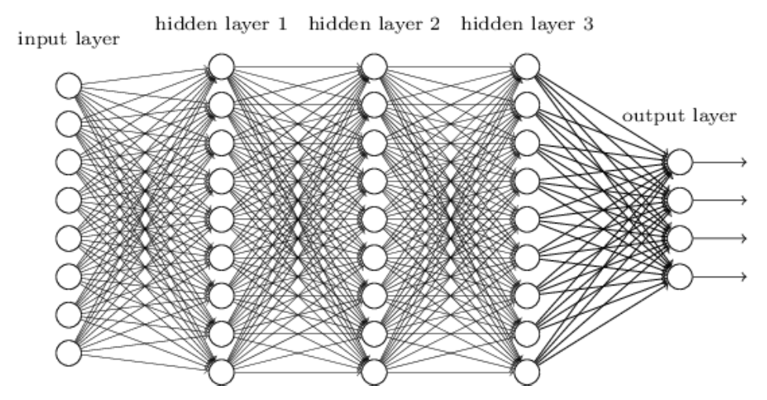
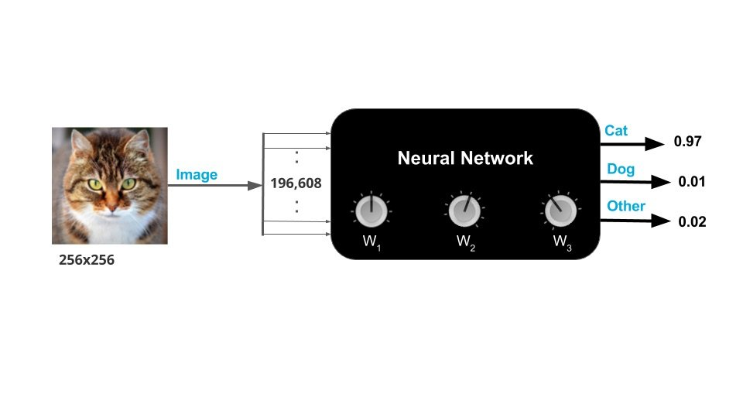
Fully Connected Neural Network

Slide 41
What does it mean to train a Neural Network ?
The black box has “knobs” that can be used to “tune” it.
In technical jargon, these knobs are called weights/ parameters/ models.
When the knobs are in the right position, the neural network gives the right output more often for different inputs.
Training the neural net simply means finding the right knob settings (or weights) to obtain desired output.

Slide 42
How to train a Neural Network?
To train a Neural Network, you show it several thousand examples of the classes (e.g. Cat, Dog, Other ) you want it to learn.
This kind of training is called Supervised Learning because you are providing the Neural Network an image of a class and explicitly telling it that it is an image from that class (label).

Slide 43
How to train a Neural Network?
To train a neural network we need three things:
Training data: Thousands of images of each class and the expected output. For example, for all images of cats in this dataset, the expected output is (1, 0, 0).
Cost function: A cost function sums up the errors made by the neural network over all images in the training set. The goal of training is to find the knob settings that will minimize the cost function.
How to update the knob settings: to update the knob settings based on the error we observe over all training images (SGD with backprop)

Slide 44
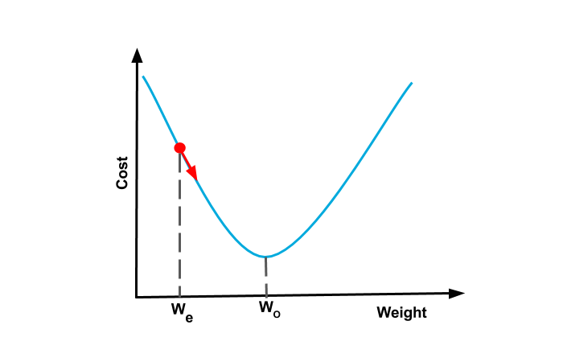
Gradient Descent
Imagine our cost function is shaped like a bowl
If our current estimate of weight is W_{e,} we could find the slope of the cost function and move a step closer to the optimum knob setting W_{o}
This procedure is called Gradient Descent because we are moving down (descending) the curve based on the slope (gradient)
We stop training when the minimum is achieved (converged)

Slide 45
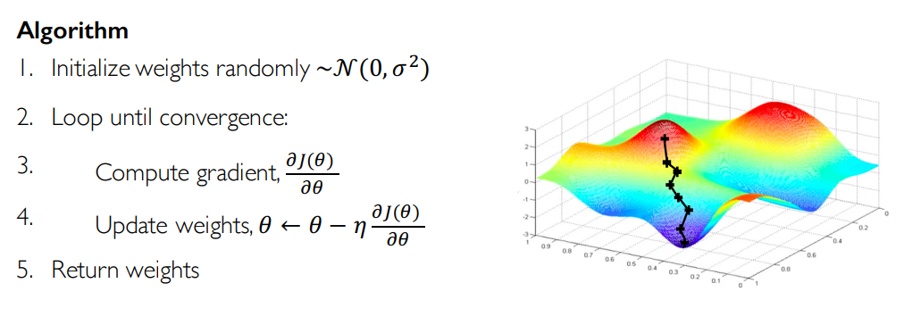
Gradient Descent
Learning rate

Slide 46

Gradient Descent: learning rate
Learning rate → controls the convergence of cost to its minimum

Slide 47
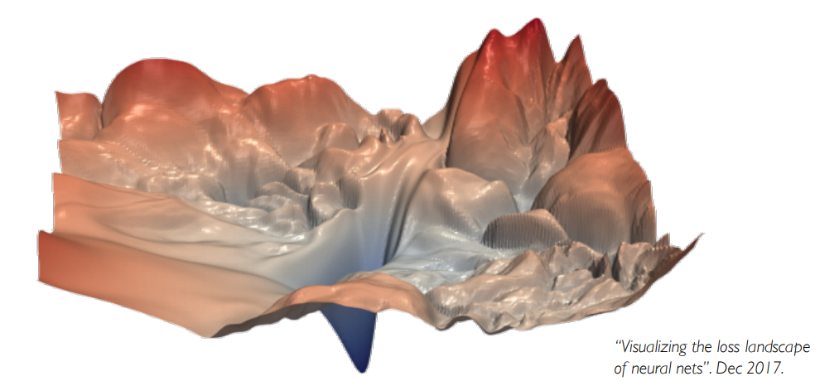
Cost function in high dimensional space!

Slide 48

Let’s implement some neural networks!
It is easy using Keras with Tensorflow backend
In Matlab, you can use matconvnet

Slide 50
Neural Networks in Practice: Mini-batches

Slide 51
Gradient Descent
Can be extremely computational expensive!

Slide 52
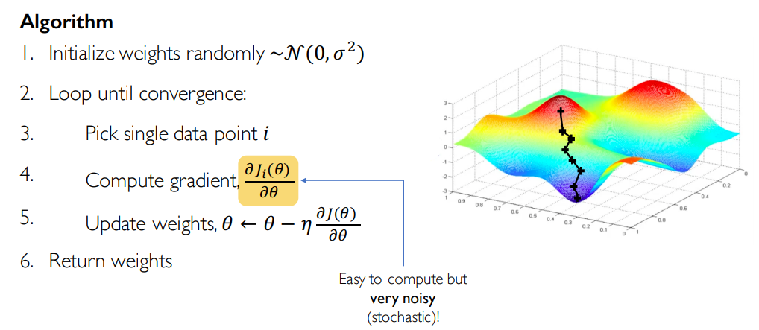
Stochastic Gradient Descent

Slide 53
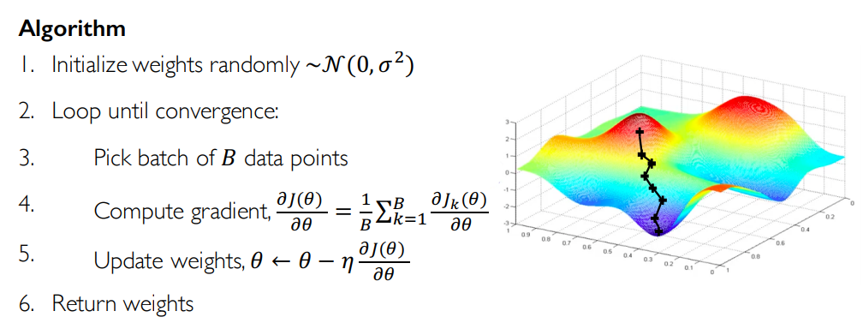
Stochastic Gradient Descent

Slide 54
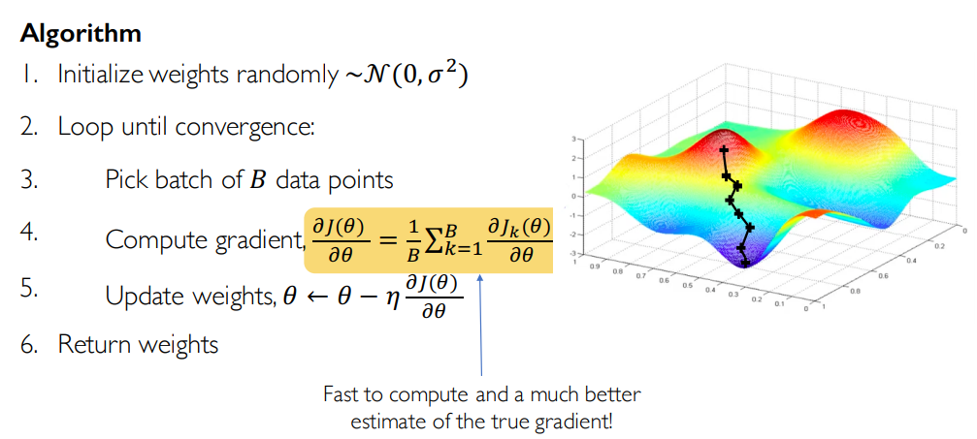
Mini-batch Stochastic Gradient Descent

Slide 55
Mini-batches while training
More accurate estimation of gradient
Smoother convergence
Allows for larger learning rates
Mini-batches lead to fast training!
Can parallelize computation
Achieve significant speed increases on GPU’s

Slide 56
Neural Networks in Practice: Overfitting

Slide 57
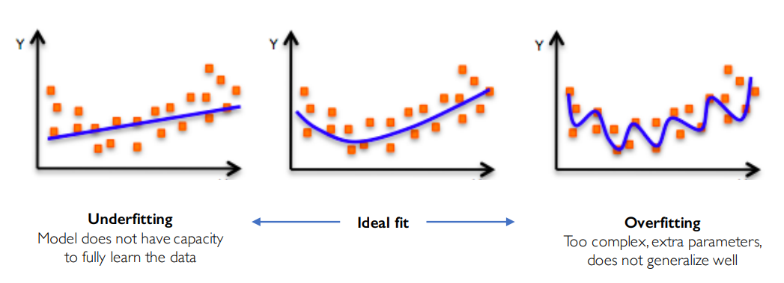
The Problem of Overfitting

Slide 58
Regularization
What is it?
Technique that constrains our optimization problem to discourage complex models
Why is it needed?
Improve generalization of our model on unseen data by combatting overfitting
if there is noise in the data (which is often the case) the network may try to learn the nonlinearity introduced by the noise too, trying to fit the noisy samples. In such cases, the noisy samples should be treated as outliers

Slide 59
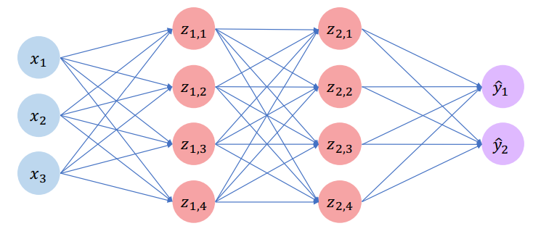
Regularization 1: Dropout
During training, randomly set some activations to 0

Slide 60
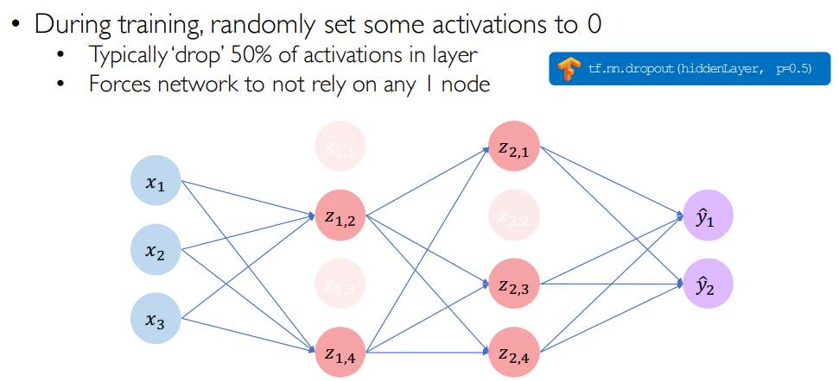
Regularization 1: Dropout

Slide 61
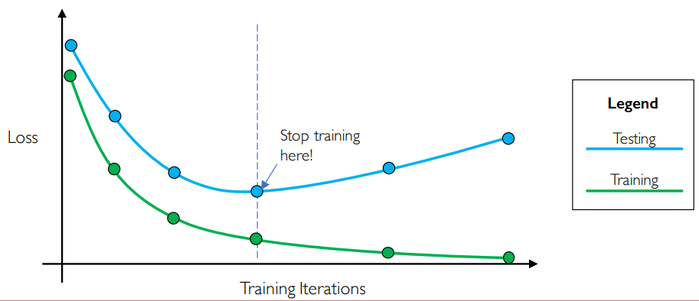
Regularization 2: Early Stopping
Stop training before we have a chance to overfit

